Slide 1


ENVIRONMENTAL MONITORING AND MODELLING TOWARDS SUSTAINABLE AQUACULTURE DEVELOPMENT
(AQUAPARK)
Norad funded project

Slide 2
CONCEPT OF MARIPARK
OUTLINE
I. Introduction A. Definition B. Major goals C. Concept of MP D. Features of a mariculture park E. Expectations from a Mariculture Park II. Existing MPs as of January 2011 A. Example of a Mariculture Park B. Status and projections C. Project/programs and beneficiaries 1. Marginalized group 2. Private investors D. What have been done | III. What do we plan to do? A. Formulate guidelines in establishing MPs B. Data collection to attain the objectives 1. Environmental survey 2. Economics survey 3. Socio-economic survey 4. Site selection/GIS C. Marketing strategies D. Recommendations

Slide 3
INTRODUCTION
DEFINITION:
Mariculture Park in the Philippines
an integrated business approach in aquaculture which has been
adopted and promoted by the Bureau of Fisheries and Aquatic
Resources (BFAR) in partnership with the private and public sectors.
The concept of the Mariculture Park is patterned after the
development of an industrial estate in the sea, wherein aquaculture
plots are leased to investors/aquaculture farmers and infrastructure
(mooring systems, navigation lanes and docking areas), utilities
(support facilities) and technical services are provided by the
government
MAJOR GOALS:
• to ensure food security
• create livelihood opportunities for coastal communities.
(Source: Adora, unpublished).

Slide 4
FEATURES OF A MARICULTURE PARK
Mariculture park development follows a pro-environment
outlook; it is also a valuable tool for coastal resources
management.
In the mariculture park, the government sustainably
manages the activities by: regulating the number and
sizes of cages and other structures.
The management of mariculture parks is ecosystem-
based and takes into consideration the ecological, social,
economic and institutional aspects of development
(Adora, unpublished).

Slide 5
Features of a mariculture park, continued
A Mariculture Park creates an enabling environment wherein
aquaculture farmers can operate their farms securely, cost-
effectively and sustainably with the integration of support
systems vital to the success of investments, such as:
technically skilled workforce and service providers,
accessible and available sources of input, markets,
financing facilities and; infrastructure (hatcheries, ice plant
and cold storage, pier, laboratories, transport facilities)
responsive governance.
The industry support systems extends throughout the
whole supply value chain. (Adora, unpublished).

Slide 6
EXPECTATIONS FROM MARICULTURE PARK
Developing mariculture park networks is part of BFAR’s
master plan to:
• promote the propagation of high-value species (e.g.
particularly groupers, sea urchin and abalone.
• create more livelihood opportunities and increase
the fishermen’s income
BFAR envisions these mariculture parks as networks serving
as trading posts for high-value fisheries, which will enable
vessels with ‘live wells’ to ply nautical highways to pick up
live fish enroute to local and international markets
(Sarmiento).

Slide 7
STATUS OF MARIPARK
As of April 2010 (BFAR Annual Report 2010), there were 50MPs in the country located in strategic places (An increase of 4 MPs from 46 in November 2009)
The target number of MPs in the Philippines is 79
Classification of MPS based on FOO 74
• Class A : Presence of favorable locational factos
• Class B : With high potential of/on-going process of achieving ideal locational factors
• Class C : With high potential of achieving ideal locational factors
• Class D : MPs that are completely dormant

Slide 8
EXAMPLE OF A MARIPARK
Panabo City Mariculture Park
(PCMP)

Slide 9
PANABO CITY MARICULTURE PARK
TOTAL Area 1,075 hectares
covering 3 coastal barangays: San Pedro, Cagangohan & J.P. Laurel
Legal Basis: Ordinance No. 02-06
60 hectares - - - - - - - - - for marine fish cages
20 hectares - - - - - - - for seaweeds-
The Mariculture Park is projected to produce:
ọ different finfishes for sea cage farming (milk fish, siganid,
grouper, red snapper)
ọ Seaweeds
ọ Shell fishes (mussel, oysters)
ọ Other high-valued species (lobsters, seahorses, etc.)
Allocate areas for coral reef and sea grasses
Identify areas for aquasilviculture activities

Slide 10
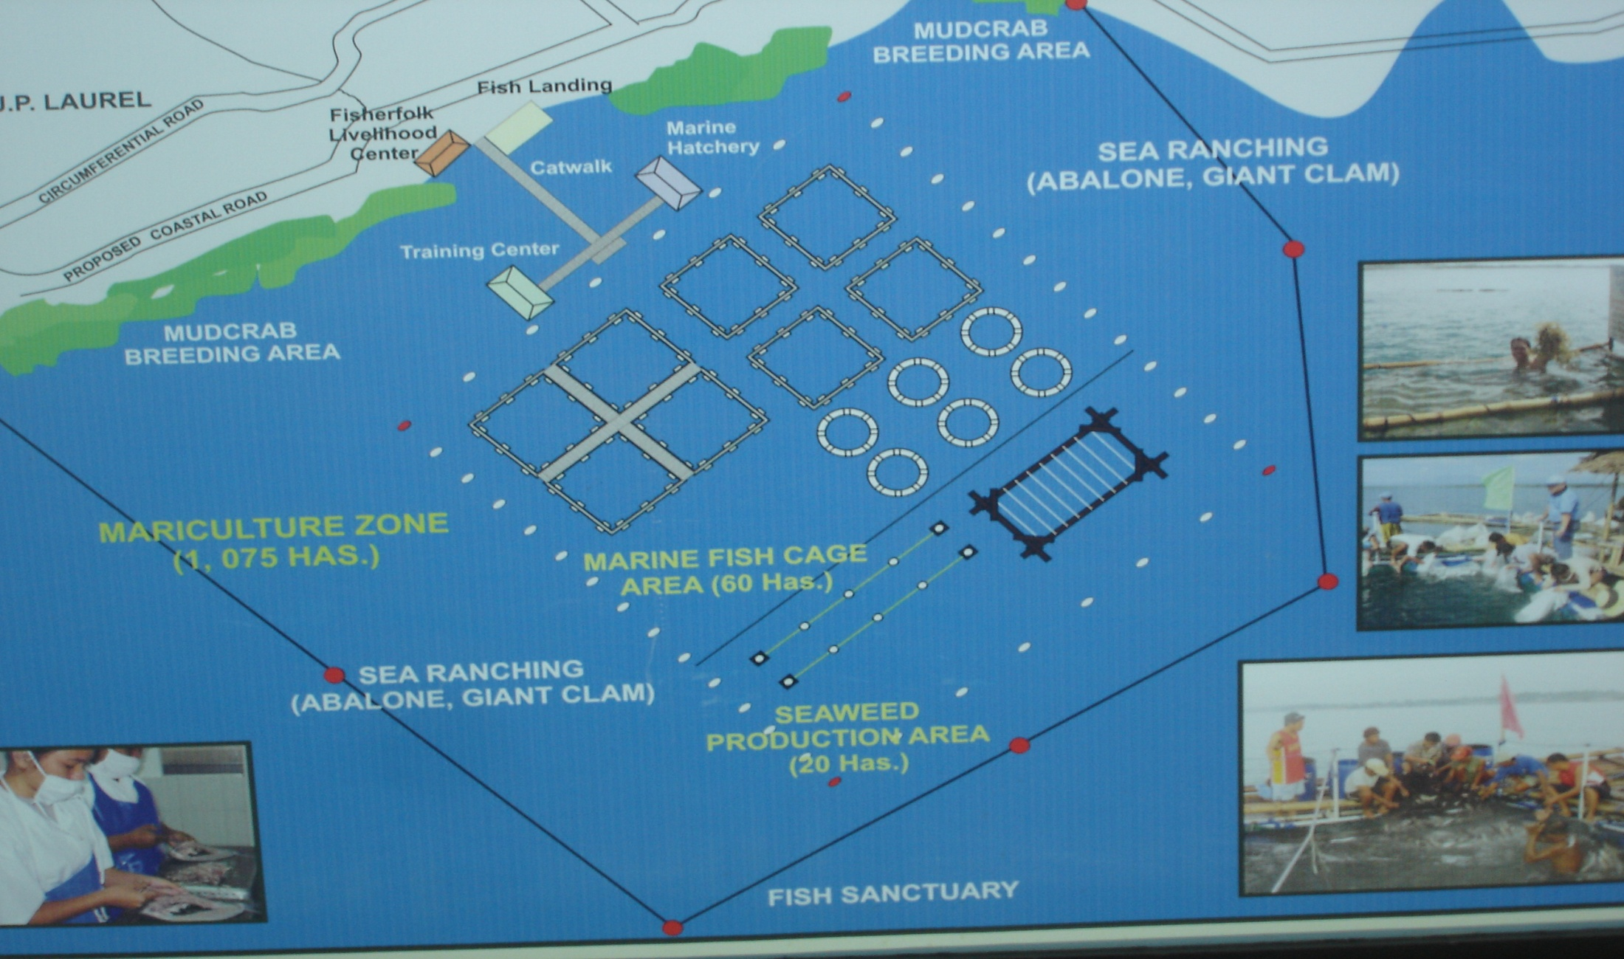
LAYOUT PLAN OF PCMP

Slide 11
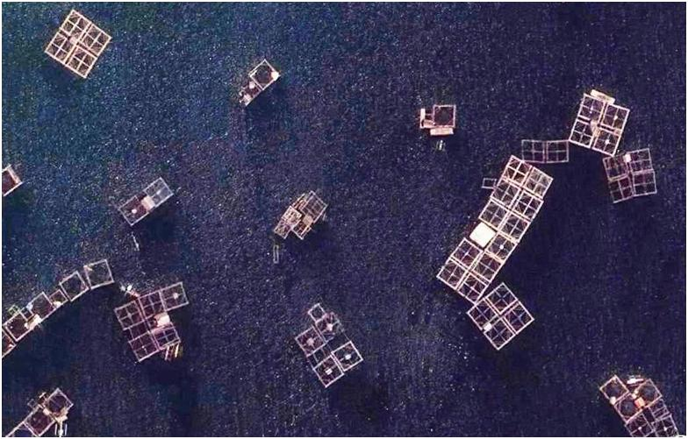
PORTION OF THE PANABO CITY MARICULTURE PARK

Slide 12
PANABO CITY MARICULTURE PARK
STATUS:
More investors are coming in and venturing on mariculture
production with the continued development of Panabo
Mariculture Park. Among the investors are: Japanese,
Ecuadorian, and Taiwanese businessmen
the park is located in Barangay J.P. Laurel, Cagangohan, and
San Pedro (Panabo City)
Opened in 2006, this joint project of the Department of
Agriculture, Bureau of Fisheries and Aquatic Resources (BFAR),
the Panabo local government, and the Province of Davao del
Norte, has shown sustainability.
For more than three years now, the mariculture park continues
to contribute food security especially to Mindanao provinces,
job employment, increased fish stocks in the coastal-marine
waters, and to the promotion of ecotourism development.

Slide 13
PANABO CITY MARICULTURE PARK STATUS, continued
From 2006 to 2008, the Panabo Mariculture Park
catered to more than 400 cages for fish and areas
for seaweeds culture.
From January to July 2008 with 65 cages only, the
Mariculture Park generated 103.28 MT of fishes
amounting to Php 9.17 million and contributed
around Php 36 million worth of investments in the
city.

Slide 14
PROJECT/PROGRAM BENEFICIARIES
MARGINALIZED GROUP
  Cooperatives
    Agricultural Cooperatives (Bien coop)- self-finance - 1 unit
    Agrarian Reform Beneficiaries (DARBCO)- self-finance 1 unit
  Women organization(KABIAC)- DIDP funded project 1 unit
  Out-of-school Youth (Caretaker’s Assn)- BFAR funded 1 unit
  FARMC/Bantay Dagat – -----------------------(BFAR funded 1 unit
  Fisherfolk Families and Organization/associations- 10 units
  BFAR/LGU finance
  Panabo Coastal Schools-Coastal Resource Management 2 units
  (CRM)- DepEd/BFAR/LGU funded

Slide 15
PROJECT/PROGRAM BENEFICIARIES, continued
B. PRIVATE INVESTORS*
  1. Small/Medium-scale businessmen (self finance)- - 90 units
  2. Civic Organization – (group finance)- - - - - - - - - 8 units
  3. Medical practitioners – (self-finance) - - - - - - - - 30 units
  4. ACES Polytechnic College – (self-finance) - - - - 8 units
  _____________________
  Local and foreign investors
  Activities of the private investor group will more of the business.

Slide 16
FROM EMMA1
Following the success of EMMA1, significant information from the different aquaculture systems were generated and relevant recommendations have been made as foillows:
Reduction of nutrient output by improving food conversion rate
Utilisation of nutrients from fish production by extractive species
such as oysters in marine and brackish water and hydroponics in
freshwater
Zoning of aquaculture into areas away from sensitive habitats and
within carrying capacity of that zone
Farm management and planning solutions to reduce benthic
impact
(Draft Final Report:Environmental Monitoring and modelling of aquaculture in risk areas of the
Philippines (EMMA2007).

Slide 17
THANK YOU

